Slide 1
Hair Rendering with Mitsuba
Michael Wan, Quan Huynh

Slide 2
Background
Based on Stephen Marschner’s and Eugene d’Eon’s scattering models
Longitudinal scattering and azimuthal scattering
Created custom BSDF class in Mitsuba Renderer, a physically-based renderer

Slide 3
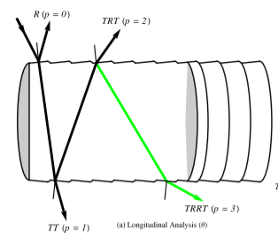
Reflectance / Transmittance Components
R – single reflectance
Responsible for specular primary highlights
TT – double transmittance
Forward scattering; lighter color hair is brighter when lit from behind (light goes through hair fiber)
TRT – transmittance-reflectance-transmittance
Secondary lighting; weaker than specular, but creates diffuse gradient

Slide 4
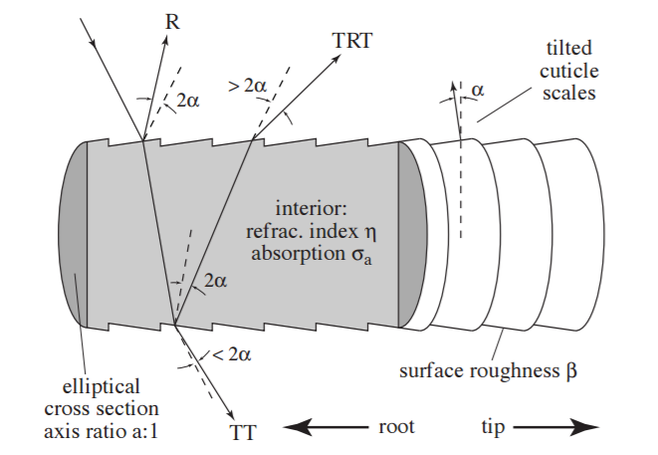
Longitudinal Scattering
Hair fiber modeled as a cylindrical shape
Alpha value
Longitudinal shift of light ray due to conic shape of hair fiber
Beta value
Longitudinal deflection out of specular cone

Slide 5
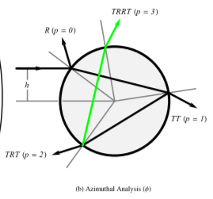
Azimuthal Scattering
Hair fiber modeled with circular cross section
Azimuthal offset h
Offset from center of circle; where light ray hits
Approaches for value h
Randomized h
Fixed h

Slide 6
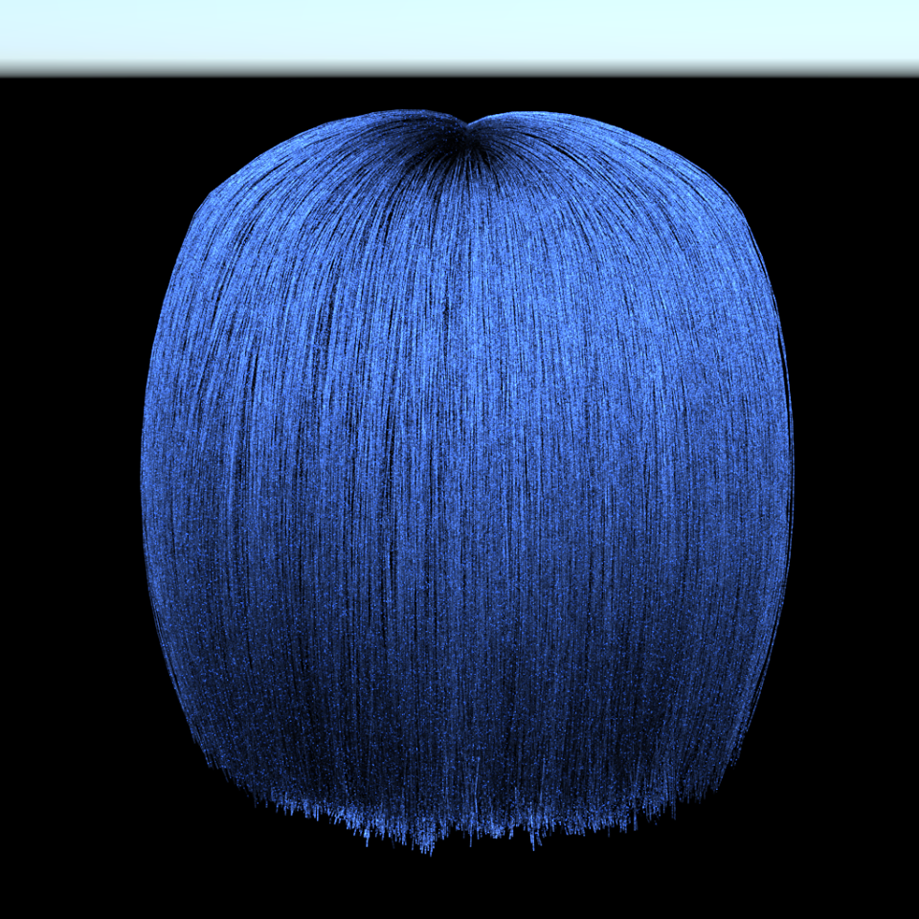
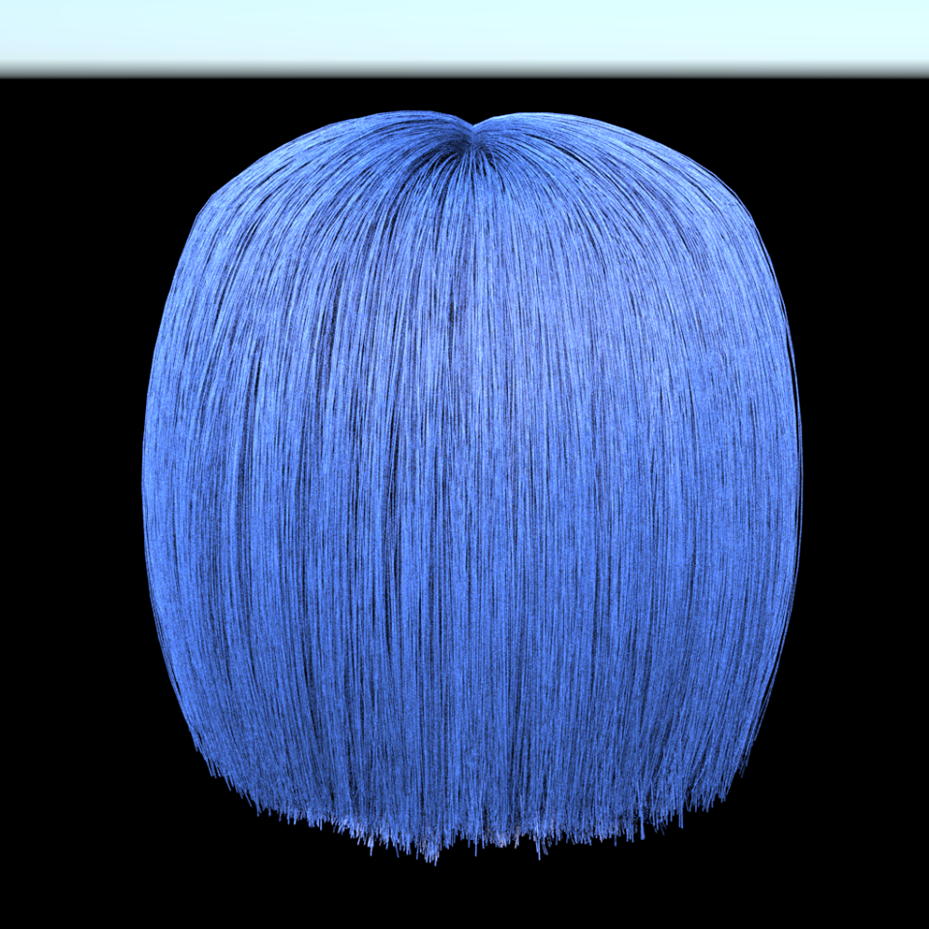
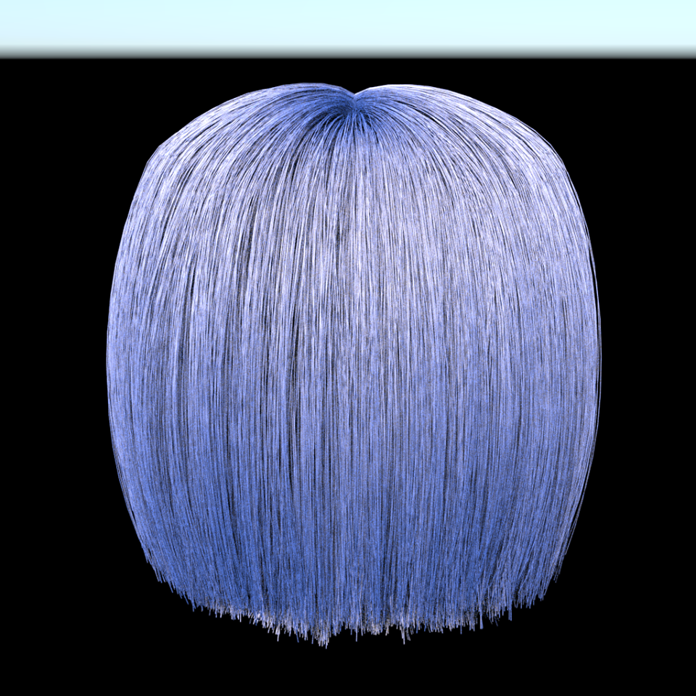
Results – changing beta
Beta – longitudinal deflection out of specular cone
alpha = 0.1; beta = 0.1
alpha = 0.1; beta = 0.2
alpha = 0.1; beta = 0.3

Slide 7
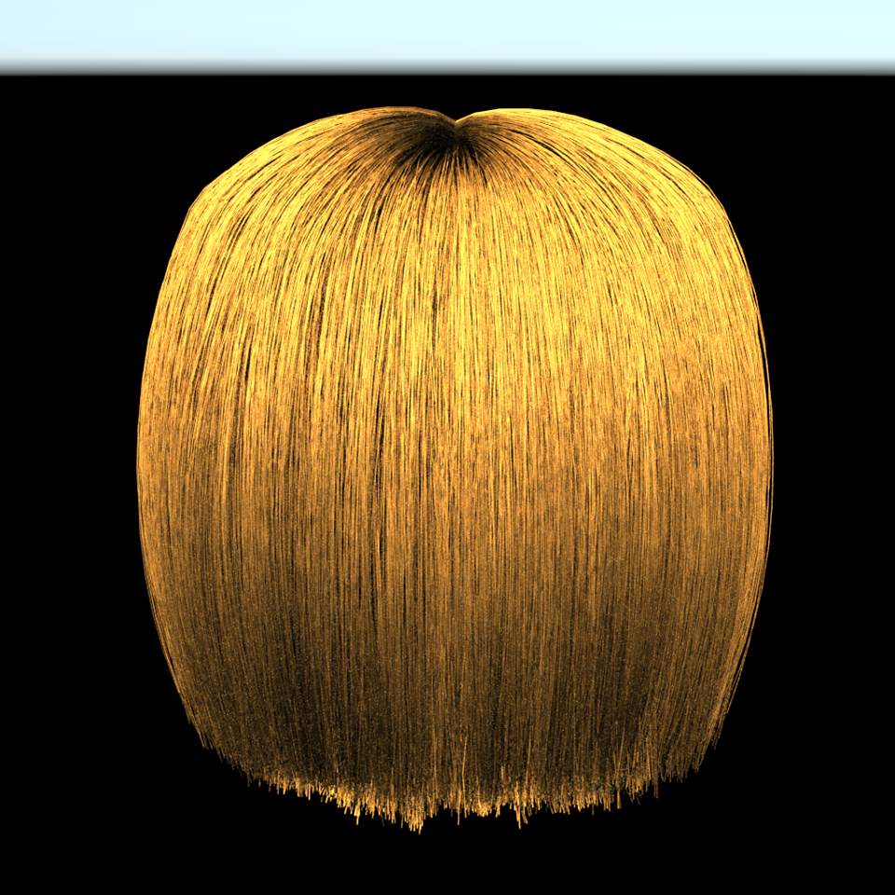
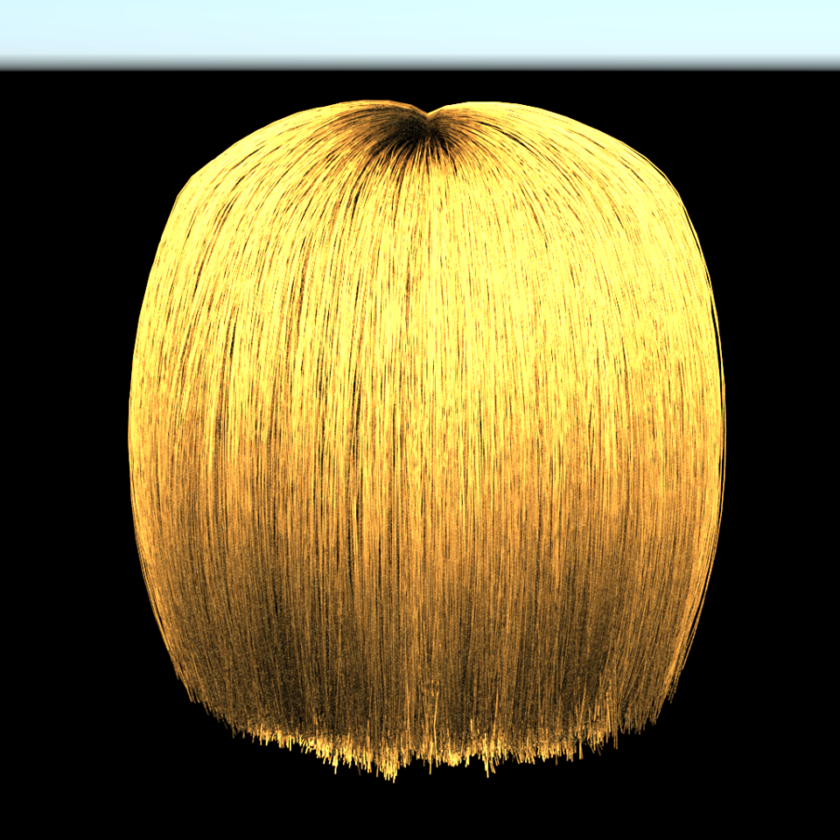
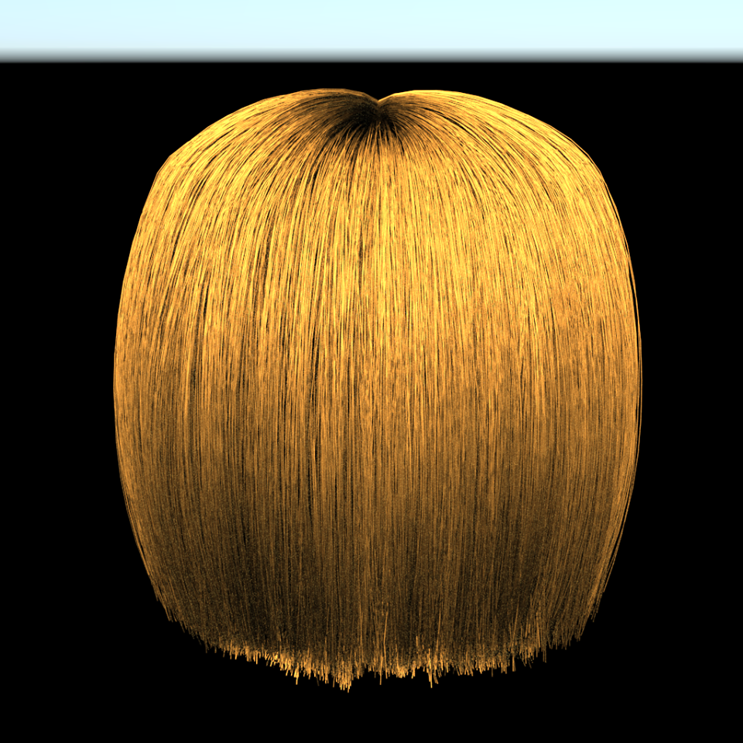
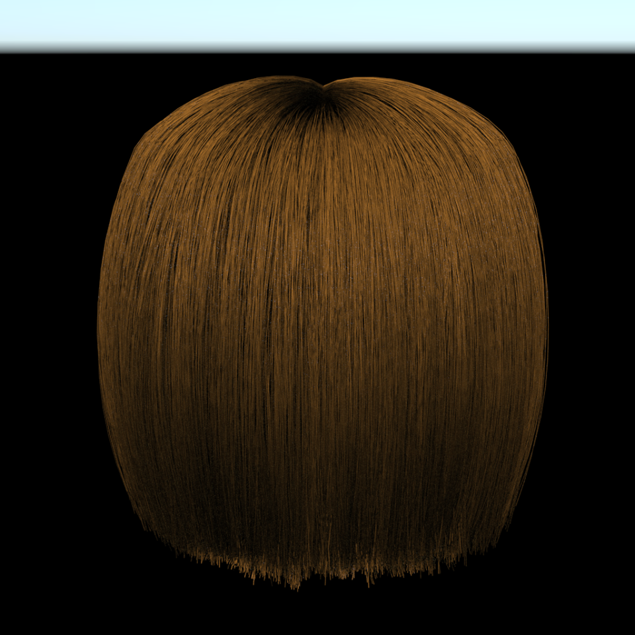
Results – changing h
h – offset from center of circular cross section in azimuthal plane
h = 0.4
h = 0.5
h = 0.6
randomized h, notice the noise

Slide 8
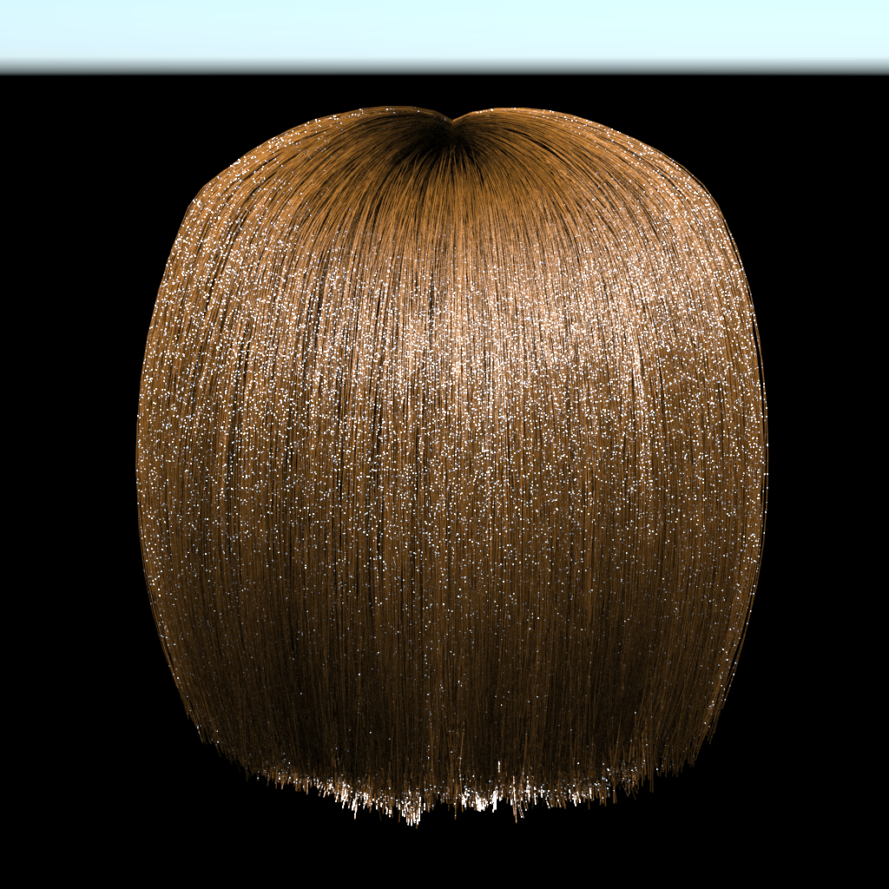
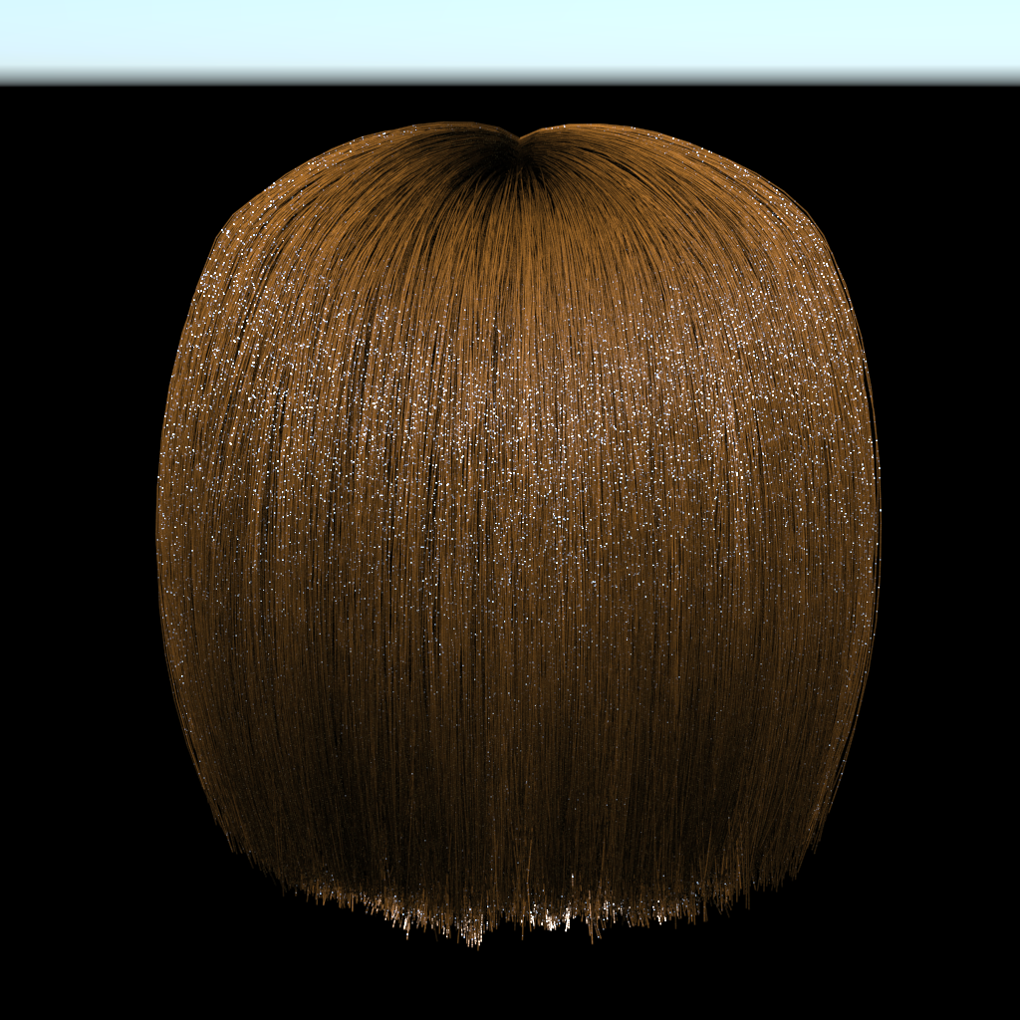
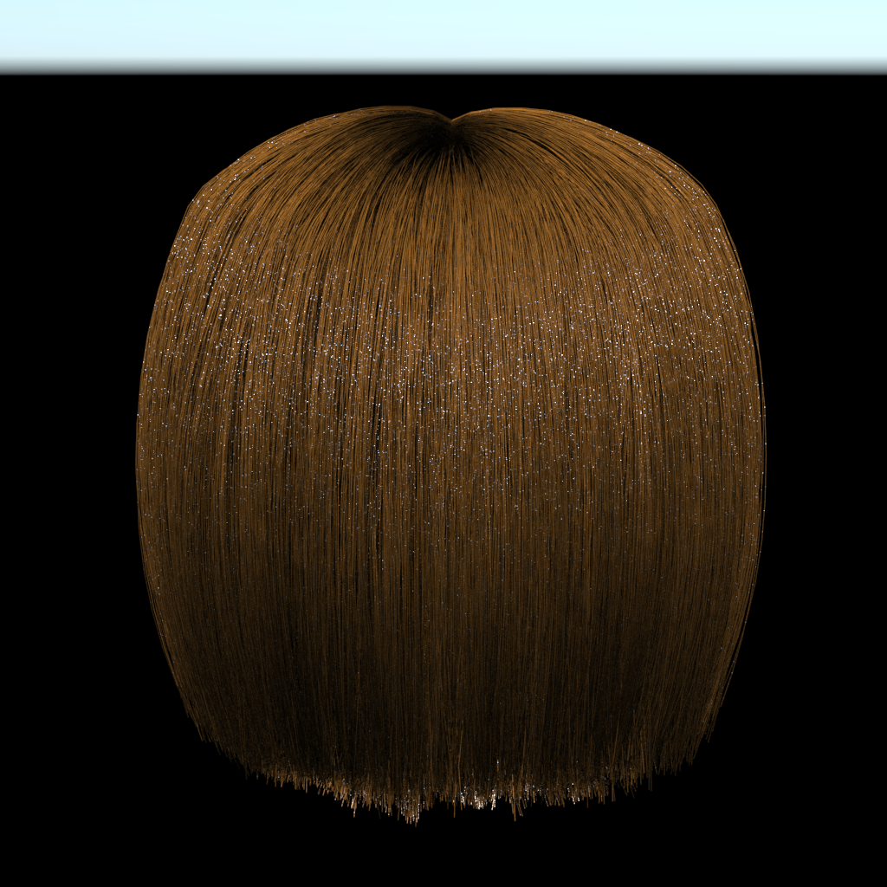
Results – scaling R component with variable h
R component – primary specular component
h = 0.6
h = 0.61
h = 0.616

Slide 9
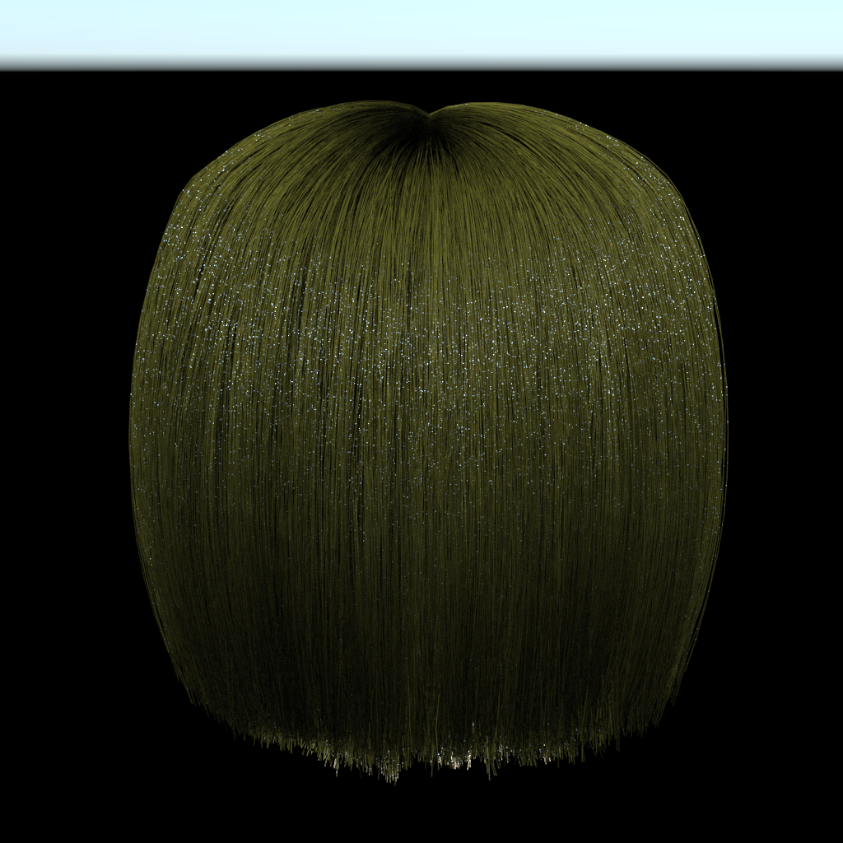


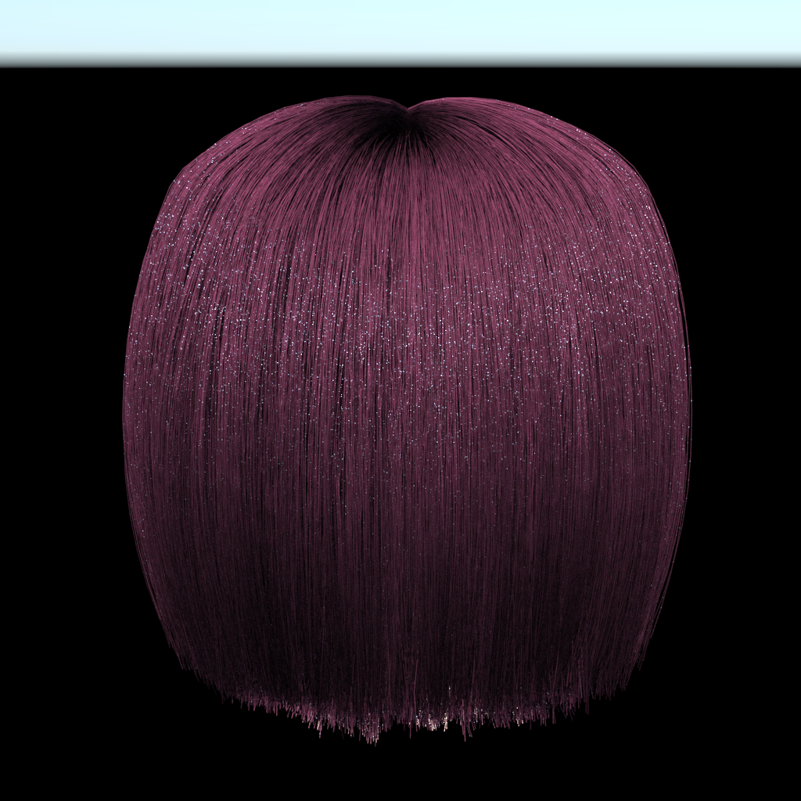
Results – changing colors
Melanin absorption coefficients – dictates hair color

